Slide 1
A CASE STUDY PRESENTATION ON ALCOHOLIC LIVER CIRRHOSIS AND HYPERTENSION
PRESENTED BY
MAMAH CHINEMEREM .P.
SUPERVISOR
DTN. ONYEKWELU CHIMDI
OCTOBER,2024

Slide 2
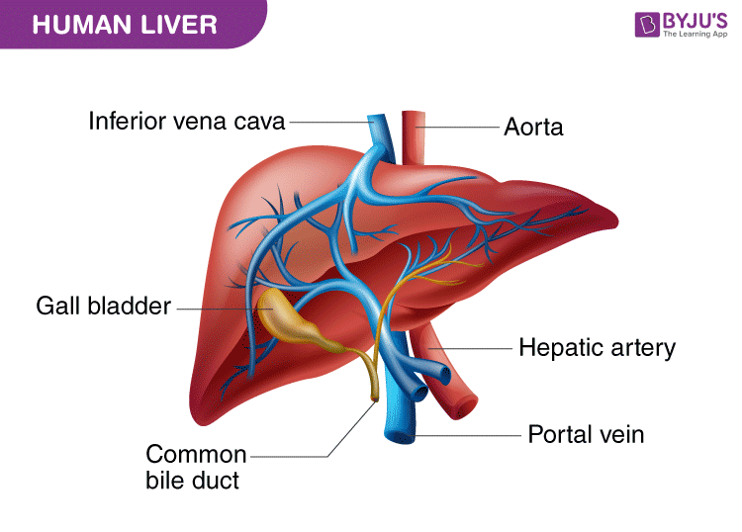
OVERVIEW THE HUMAN LIVER
The liver is a critical organ in the human body that is responsible for an array of functions that help support metabolism, immunity ,digestion, detoxification, vitamin storage among other functions.

Slide 3
STRUCTURE OF THE LIVER
The liver is a dark reddish brown gland that accounts for 1-2.3kg of the total body weight.
it has 4 lobes and is situated at upper part of the abdominal cavity.
The liver has a double blood supply, the portal vein brings venous blood from the intestines and the spleen, and the hepatic artery supplies the liver with arterial blood.

Slide 4
LIVER CIRRHOSIS
Liver cirrhosis is a chronic and permanent scarring of the liver.
This scarring is as a result of persistent liver damage over the years which in turn interfers with it’s functioning.
Liver cirrhosis is the last stage of liver disease . Here the healthy liver tissues are then replaced with scar tissues which can eventually lead to liver failure.

Slide 5
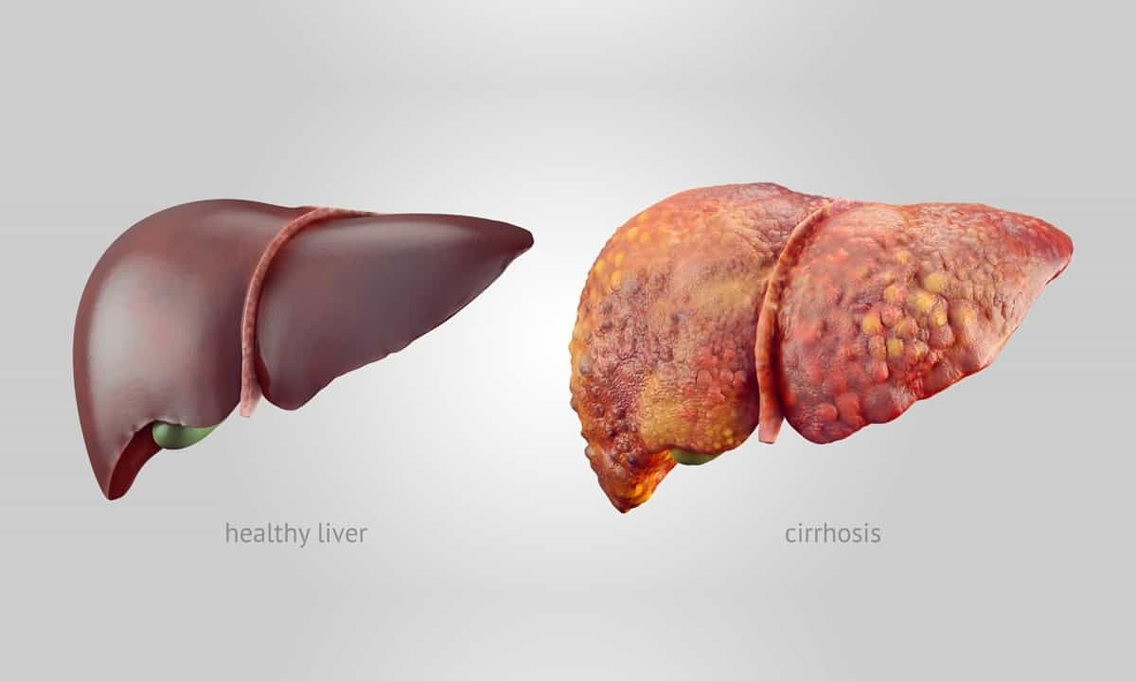
HEALTHY LIVER VS CIRRHOSIS

Slide 6
CAUSES OF LIVER CIRRHOSIS
The most common cause of cirrhosis includes
Long term alcohol abuse
Fatty liver disease (NAFLD) : This is as a result of build up of fats in the liver and can be linked to obesity ,High blood pressure,diabetes,hip cholesterolemia.
Drug induced liver cirrhosis
There is no cure for cirrhosis but it’s possible to manage symotoms and slow it’s progression.

Slide 7
SIGNS AND SYMPTOMS
Cirrhosis often has no symptoms until it damages the liver. when symptoms do occur, they may include:
Ascites
Oedema
Body weakness
Weight loss
Periods of mental confusion /drowsiness
Hematemesis (Vomiting of blood)
Dark urine or stool
Jaundice

Slide 8
COMPLICATIONS OF LIVER CIRRHOSIS
Liver Failure
kidney Failure
Hepatic encyclopathy
Splenomegly
Portal hypertension
Infection Suseptibility
Coma
Malnutrition and Vitamin deficiecy
Malabsorption /altered metabolism

Slide 9
PREVENTION OF LIVER CIRRHOSIS
Avoid alcohol : alcohol makes the liver work harder to do it’s job
Maintain a healthy weight
Get vacinated
Practice safe sex
Avoid over the counter medications
Wash produce: pesticides and toxins could damage the liver
Practice good hygeine

Slide 10
NUTRITION MANAGMENT
People with cirrhosis require more energy and protein in their diet than people who have a healthy liver.
This is because liver cirrhosis makes the body unable to digest and absorb carbohydrate effectively.
Energy from food lasts two hours so the body finds an alternative energy source, usually protein stores (muscles)
. If this happens one may notice weakening and wasting of muscles leading to reduced strength.

Slide 11
NUTRITIONAL MANAGMENT CONT’D
Having four to six snack meals rather than one or two bigger meals, so that energy and protein intake is spread through the day .
Poultry, fishes, eggs, pulses, milk, yoghurts and cheese as a good source of protein, as a healthy alternative to red meat.
Eating starchy (carbohydrate) foods will help provide energy more slowly over a longerperiod
it’s important to consume lots of fruits and vegetables and reduce intake of fats & sodium.

Slide 12
HYPERTENSION
Blood pressure is the force exerted against the walls of the blood vessles (ateries) while circulating blood.
This pressure depends on the resistance of blood vessels and how hard the heart has to work.
BP is written as two numbers, the first (systolic) number represents the pressure in blood vessels when the heart contracts or beats. The second (diastolic) number represents the pressure in the vessels when the heart rests between beats.

Slide 13
HYPERTENSION CONT’D
Hypertension is referred to when the blood pressure is high or elevated
Hypertension is diagonised if when overtime or on two occassions, a persons systolic blood pressure readings is => 140mmhg or diastolic BP reading is => 90

Slide 14
TYPES OF HYPERTENSION
Primary hypertension: also called essential hypertension results from plague buildup in the arteries (atherosclerosis)which increases blood pressure. This can be from build up of fats,cholesterol and other substances.
Secondary hypertension: this results from different underlying medical conditions such as adrenal gland tumor and congenital heart defects. also medications such as pain reliefs ,non steriodal anti inflammatory drugs(NSAIDS)and oral contraceptives.

Slide 15
RISK FACTORS OF HYPERTENSION
Modifiable factors: such as unhealthy diets(excessive consumption of salt,saturated fat,trans fats). Low intake of fruits and vegetables,physical inactivity,consumption of alcohol,pregenancy.
Non modifiable factors: like Family history of hypertension, age, co-existing diseases such as diabetes, kidney disease,obesity.

Slide 16
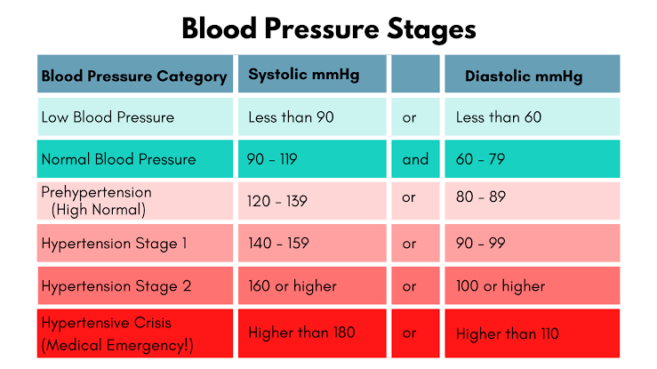
BLOOD PRESSURE RANGES

Slide 17
SYMPTOMS OF HBP
Hypertension is called a ‘’silent killer’’ most people with hypertension are unaware because it may have no warning signs or symptoms. For this reason, it is important that BP is measured regularly.
When symptom occur, they may include early morning headaches,irregular heart rhythm,retinopathy and buzzing ears.
Severe hypertension can cause fatigue nausea,vomitting,confusion,muscle tumors.

Slide 18
COMPLICATIONS OF HBP
Heart attack
Stroke
Heart failure
Vision loss
Peripheral artery disease
Metabolic syndrome

Slide 19
MANAGMENT OF HBP
Hypertension can be managed with regular exersise,stress reduction,medication,diet weight and management.
Dietary management
DASH DIET: Dash stands for dietary approach to stop hypertenshion.
Eating more fruits and vegetables & low fat dairy foods.
Choose carbohydrate sources from whole grains
Cut down on saturated fats,cholesterol & transfat
Limit sodium intake to 1.5 miligrams/day
Limit sugar intake,sweets,drinks and red meats.

Slide 20
MEDICAL NUTRITION THERAPY

Slide 21
I hereby present a medical case of a 74 year old man with Alcoholic liver cirrhosis and Hypertension.
Ward: Female medical Ward
Consultant: Dr. Anyanochi C.C
Medical diagnosis:Alcoholic liver cirrhosis and hypertension
Date of admission: 29/9/2024
Date case commenced: 9/10/2023
Date of discharge: 22/10/2024
Informant: Patient’s wife and son

Slide 22
NUTRITION ASSESSMENT
Family and social history
Patient is 74 year old man who hails from Isu in Nwangege LGA of Imo state and resides in Aba, Abia state.
PT is married in a monogamous setting with 3 Children (2M,1F).
PT is a Christian of Redeem Church
He is a brick layer and his highest level of education is SSCE
PT lives in a 2 bedroom apartment
Source of drinking water is borewhole
Mode of fecal disposal is WC

Slide 23
NUTRITION ASSESSMENT
Past Medical History
PT has a family history of hypertension.
PT has no history of surgery or transfussion.
PT has no history of EADS.
Present Medical History
PT was apparently until a day prior to admission developed breathlessness.
PT was being managed for Alcoholic liver cirrhosis and hypertension.

Slide 24
NUTRITION ASSESSMENT
Anthropometry
Patient was non-ambulatory
BROCAS formular was used to take his length170m, weight= 70kg (170-70)
Biochemical assessment
Tests | Dates | Values | Normal ranges | Indication
Cretinine Serum | 10/10/2024 | 66mmol/L | 57-113mmol/l | High
Bicarbonate (C02) | 10/10/2024 | 31.7mmol/l | 32.0-30.0mmol/l | High
Potassium Serum | 10/10/2024 | 4.73mmol/l | 3.5-5.1mmol/l | High

Slide 25
NUTRITION ASSESSMENT
Nutrition focused physical findings
O/E: An ill looking man met lying on the bed, pale, in an obvious respiratory distress, not dehydrated, afebrile to touch, acynosed, ascites, bilateral pitting Oedema.
Vital Signs
Date | BP(mmhg) | Pulse rate (b/m) | Respiratory rate (b/m) | SP02 (%)
9/10/24 | 130/80 | 80 | 28 | 94
22/10/24 | 110/80 | 91 | 22 | 96

Slide 26
NUTRITION ASSESSMENT
Food and nutrition related history
Patient is a voracious eater (consumes about 900g of eba).
Loves eating vegetable soup and has no food dislikes.
Patient is a known alcoholic (consumes a lot of spirit).
Consumes fizzy drinks and confectionaries.
Patient takes vegetables occassionally and fruits spairingly.

Slide 27
24 HOUR DIETARY RECALL
MENU | FOOD ITEM | QTY (g) (Estimated) | KCAL | CHO (g) | CHON (g) | FAT (g)
BREAK FAST | PAP | 100 | 51 | 8.8 | 1.1 | 1.0
LUNCH | AGIDI | 300 | 280.02 | 59.25 | 5.52 | 1.47
DINNER | AGIDI | 200 | 280.02 | 59.25 | 5.52 | 1.47
TOTAL |  |  | 611.4 | 127.3 | 12.14 | 3.94

Slide 28
NUTRITION DIAGNOSIS
Excessive alcohol intake RT food and nutrition knowledge deficit and lack of value for behavioural change AEB food and nutrition related history.
Increased protein needs RT hypercatabolism AEB altered laboratory values

Slide 29
NUTRITION INTERVENTION
Goals of MNT
To encourage healthy eating habits, portion controls, while considering individual requirement and food prefrences.
To provide adequate support for patient’s medical condition.
To restore blood pressure to within normal range.
To improve quality of life and decrease overall mortality associated with the disease

Slide 30
NUTRITION INTERVENTION
Diet prescription
Patient was placed on a HCAL,LP,LF,LS diet of 2000Kcal/day.
The dietary refrence intake permits wide acceptable macronutrient distribution aranges. They allow, for example, 45% to 65 of calories from carbohydrate, 10-35% of calories from protein and 20 to 35% of calories from fat.

Slide 31
Calorie distribution of a day sample menu based on 200Kcal diet
CHO: 60% of 2000kcal = 1200 kcal
1200 / 4 = 300g
Protein: 20% of 2000kcal = 400kcal
400 / 4 = 100g
Fat: 20% of 2000kcal = 400kcal
400 / 9 = 44.4g

Slide 32
A DAY SAMPLE MENU
MENU | FOOD | QUANTITY (g) | Energy (Kcal) 2000 kcal | CHO (g) 300g | CHON (g) 100g | FAT (g) 44g | SODIUM (NA)
Breakfast | Bread | 120 | 225.4 | 41.408 | 6.556 | 8 | 12
 | skimmed milk | 20 | 73.8 | 10.4 | 6.44 | 0.16 | 0.7
 | Lipton | - | - | - | - | - | -
 | Cabbage | 50 | 2.9 | 17.1 | 0.64 | 0.05 | 9
Lunch | Garri | 500 | 516 | 78.7 | 11.55 | 0.1 | 11.4
 | Okro soup | 300 | 95.5 | 10.3 | 10.92 | 0.15 | 0.8
 | Beef | 30 | 627 | - | 16.8 |  | 0.6
Mid – Lunch Snack | 0range | 150 | 169.92 | 35.25 | 1.92 | 0.36 | -
Dinner | Jellof Rice | 300 | 354.84 | 78.99 | 7.92 | 25.2 | 1.34
Bed time- Snack | Cucumber | 100 | 9.11 | 3.63 | 0.65 | 0.11 | 1.0
TOTAL CALORIES = |  |  | 2,074.47 | 275.778 | 93.4 | 37.13

Slide 33
Drugs-Nutrient Interaction And Their Functions
Drugs | Dosage | Functions | Drug and Nutrient interaction
IV Furosemide (60mg) | 12 hourly | Used for edema reduction. It inhibits electrolyte reabsorption from the kidneys and enhance the excretion of water from the body | Increases the absorption of ibuprofen and may decrease Serum potassium
IV Ceftriaxone (1g) | 12 hourly | Used to treat a wide variety of bacteria infections | No known interaction
Tab Vitamin C (500mg) | 2x daily | Helps to protect cells and keep them healthy | Enhances the absorption of dietary iron and selenium, reduces copper, nickel and manganese absorption
Tab CaCO3 600mg | 3x daily | Helps in normal functioning of the nerves, cells, muscles and bones | Absorption may increase with food. Binds with phosphorus in the gut and block its absorption
Tab Propanolol (80mg) | 2x daily | A beta blocker used to treat high blood pressure, irregular heartbeats, migraine headaches or tremors | Caffeine containing foods may decrease its effectiveness when taken together
Tab Aldoment (1g) | 12 hourly | Used to treat high blood pressure, renal impairment and hypertensive crisis | Interferes with excess salt intake. Alcohol may increase dizziness when taken with drugs.

Slide 34
NUTRITION COUNSELLING
Patient was counselled on DASH
Patient was counselled to increase fibre intake through the consumption of fruits, vegetables and whole grains.
Counselled to take foods rich in omega 3 fatty acids like nuts, fish, flax seeds, avacado.
Counselled to adhere to low salt diet regimen and excluding all trans and saturated fats. This is to aid regressing oedema, enable blood pressure control to normal and avoid futher complications like heart disease and stroke.

Slide 35
NUTRITION COUNSELLING
Patient was counselled to maintain a particular meal timing and eat small but frequent meals.
Counselled to avoid alcohol
Counselled to avoid consuming fizzy drinks and confectionaries.
Counselled to avoid artificial spices and to stop adding salt to table.
Counselled to engage in mild physical activity such as streching.

Slide 36
NUTRITION MONITORING AND EVALUATION
Patient adhered to the new dietary regimen
The goal of medical nutrition therapy was achieved and his health improved.
On 17/10/24 patient was able to get up and move around without assistance. Ascites regressed a bit.
Patient’s blood pressure gradually improved from 130/80mmhg to 110/80mmgh.

Slide 37
REFRENCES
Abraham A, Ikramuddin S, Jahansouz C, et al. Trends in bariatric surgery: Procedure selection, revisional surgeries, and readmissions. Obes Surg. 2016;26:1371.
Adeloye, D., Ige-Elegbede, J. O., Ezejimofor, M., Owolabi, E. O et al., (2021). Estimating the prevalence of overweight and obesity in Nigeria in 2020: a systematic review and meta-analysis. Annals of Medicine, 53(1), 495-507. https://doi.org/10.1080/07853890.2021.1897665\
Jensen MD, Ryan DH, Apovian CM, et al. 2013 AHA/ACC/TOS Guideline for the Management of Overweight and Obesity in Adults: A Report of the American College of Cardiology/American Heart Association Task Force on Practice Guidelines and The Obesity Society. J Am Coll Cardiol. 2013;pii:S0735-1097(13)06030-0.
Kahn SE, Hull RL, Utzschneider KM. Mechanisms linking obesity to insulin resistance and type 2 diabetes. Nature. 2006;444:840-846.
Kaur, Jaspinder. A comprehensive review on metabolic syndrome. Cardiol Res Prac. 2014; 943162.

Slide 38

OTHER HEALTH PROFESSIONALS INVOLVED IN MANAGEMENT
Doctors
Nurses
Lab.Scientist
Radiographers
Pharmacists

Slide 39


